Slide 1
Design Patterns
Chapter 11

Slide 2
Software Barriers
Sometimes the data/object you need is just beyond your reach
Process/Platform Barrier
Permission Barrier
Database/Persistence Barrier
Efficiency Barrier
Memory Representation Barrier

Slide 3
The Nature of Barriers
Obstacles we must get around/climb over
It takes special attention, distracting us from the task at hand.
Software: it usually translate to an if-statement
  … every place the barrier might be encountered

Slide 4
Understanding Code
Studies have indicated that 50% of the software maintenance effort goes to understanding the existing code.
Learning code is very much flow-based: you get in the flow of following the program.
Extraneous if-statements break your mental flow
  Surmounting barriers has lasting effects!

Slide 5
Caveat
Don’t let barriers obscure you from solving the real problem
  SRP violation, DIP violation
  You mix problem-solving code with connectivity details (for example)
    These two may change independently
Hide the details of crossing barriers
  From the user
  From yourself

Slide 6
Process/Platform Barrier
The object you want resides in another process
That process could even be on another machine on the network
You want to be able to behave as if the object is in your own process space
  The communication details will be hidden in other, behind-the-scenes objects

Slide 7
Permission Barrier
Access to objects is protected
Details of what access levels exist and how to fulfill them is hidden

Slide 8
Persistence Barrier
An object’s data is in a database
  Usually a relational DBMS
You want retrieval and update to be automatic
  Details of which are hidden in unseen objects

Slide 9
Efficiency Barrier
You have a large object that is expensive to load or initialize
  You want to wait until it’s needed to do the work (“Lazy Initialization”)
  Or you want a thread to load it while you do other things

Slide 10
Memory Representation Barrier
The objects you use have special memory requirements
  They use reference counting to share themselves among multiple objects
  Or they are stored in an unusual fashion
    Bitsets packed into integer arrays
    They are computed on the fly

Slide 11
A Solution
Before we go on, see what you can come up with. Suggestions?

Slide 12
The Proxy Pattern aka Surrogate
Intent:
  Provide a go-between object that controls access to another object of interest
Context:
  Access to an object lies behind some kind of (conceptual or physical) barrier. You need to control access to the object of interest.
Solution:
  Introduce another level of indirection between clients and objects. The new layer controls access to objects, hiding details of penetrating barriers from clients and their server objects.

Slide 13
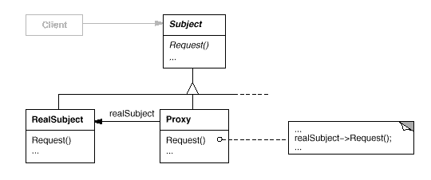
The Proxy Pattern
Class Sketch

Slide 14
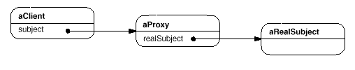
The Proxy Pattern
Object Sketch

Slide 15
The Proxy Pattern
Key Features
The proxy object implements the same interface as the original object
It wraps the original object
  It provides the code to resolve the barriers to access
  It forwards to the original object as needed

Slide 16
Example: Remote Proxy
To use an object in another process space requires inter-process communication
  Could be over a network
The “proxy” consists of two classes:
  A “stub” in the client process
  A “skeleton” in the server process
Communication:
  Requests are sent from the client through the stub to the skeleton
  Data is “marshaled” back through the skeleton to the stub to the client
See pages 437-440

Slide 17
Example: Reference Proxy
The index operator ([ ]) in C++’s std::bitset
Bits are packed into words
  And are not addressable
Accessing a bit for update is different than for retrieval
  b[i] = true; // update
  bool x = b[i]; // retrieval

Slide 18
Example: Reference Proxy
~continued~
Note: the interface is implicit
  It’s just the [ ] operator
Must somehow distinguish between left- and right-hand side usage
  LHS => assignment to a bitset
  RHS => converting a bit to a bool

Slide 19
Example: Reference Proxy
~continued~
Solution:
  Introduce a new class as a placeholder for indexing
  Overload operators to detect usage:
    The assignment operator will set a bit
    The bool conversion function will test a bit
See bits.h from CS 3370

Slide 20
Example: Persistence Proxy
Where should DB knowledge reside?
  Not in Client code!
  Certainly not in each object you want to persist (DRY)
  Remember the DIP
    Abstractions should not depend on details
  Keep business rules separate from DB details
Alternatives:
  Inherit from a class that has most of the knowledge and provide the missing pieces
    (Template Method Mixin)
  Use a Proxy (next slide)

Slide 21
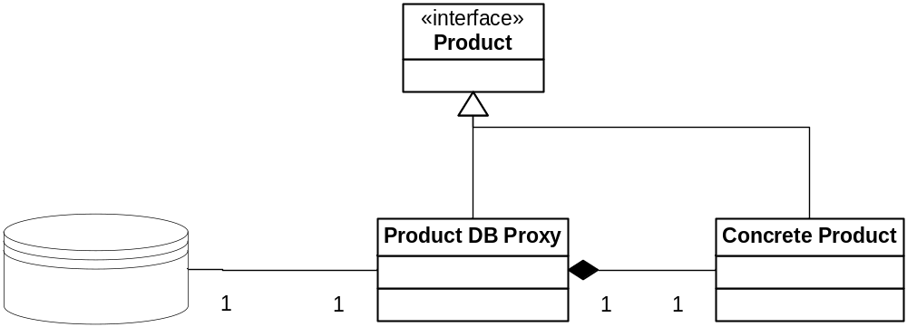
Persistence Proxy

Slide 22
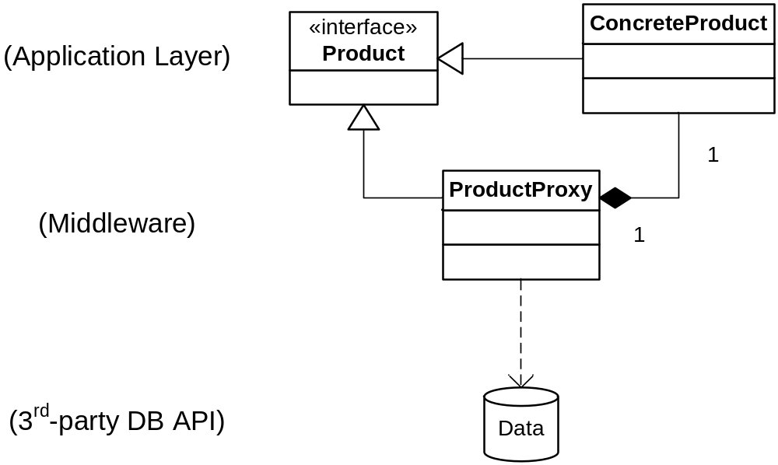
Persistence Proxy
A Layered View

Slide 23
Example: Persistence Proxy
Implementation Choices:
  1) Load at construction of Proxy
  2) Load/update on every access
  Both have issues
Example: DBProxy.cpp

Slide 24
Example: Virtual Proxy
Virtual Proxy acts like the real object
Creates the object when necessary
Delegates calls to the real object at the right time
Pages 462 - 470

Slide 25
De ja vous all over again?
Remind you of any other patterns?
It looks like a fancy decorator!
What are the differences?
Yet another fireside chat
  P. 472-473, 487

Slide 26
Example: Caching Proxy
Your guess: what’s a caching proxy?
And how does it work?

Slide 27
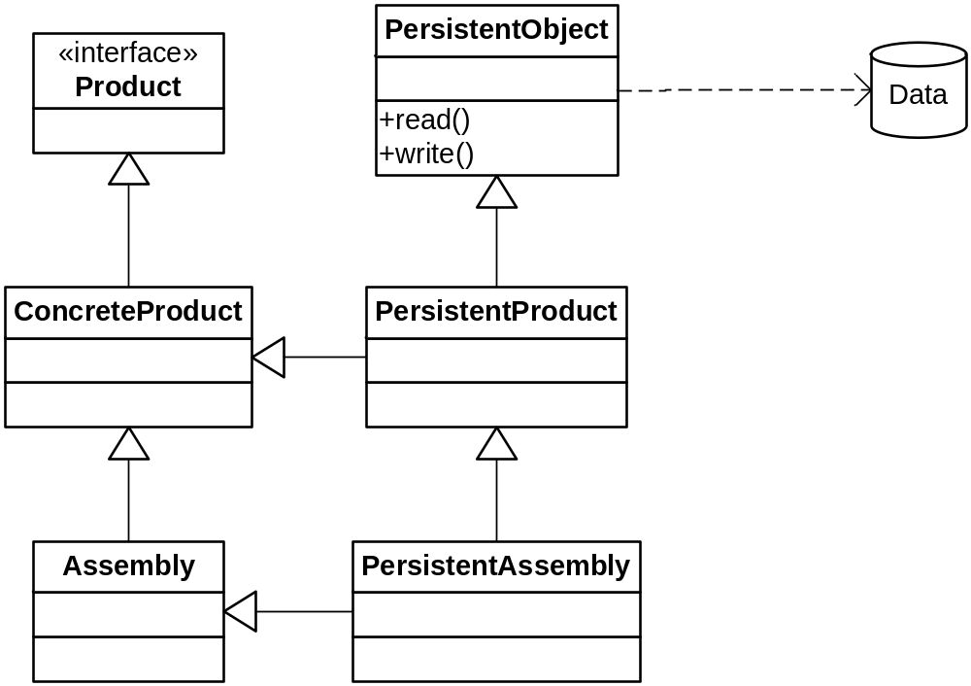
Stairway To Heaven
An Class Adapter Extension to a Persistence Proxy
MI Required

Slide 28
Other DB-Related Patterns
Visitor
  Write a visitor that knows how to write to a DB, then call accept on the object to be written
Decorator
  Can decorate an object with DB ops or vice-versa
Façade
  Works nice for smaller apps
  A monolith class does everything and then you provide a simpler interface for product-only use

Slide 29
Reference Counting
A combination of:
  Virtual Proxy
    Because some actions are delayed
  Reference Proxy
    The proxy controls memory usage
Example: Copy-on-write strings (cow.cpp)

Slide 30
Smart Pointers
A Reference Proxy
Can be used for many purposes
  Caching, RAII (resource management) reference counting, permission, even remoting (ATL COM smart pointers)
Examples:
  auto_ptr
  shared_ptr, weak_ptr

Slide 31
About operator-> in C++
It’s purpose is to yield a member of a structure or class
When you overload it, you intercept it before it yields the member
  Therefore, you do your behind-the-scenes work and finally return a lower-level pointer, p
  Then p->x is executed (so -> happens at least twice)

Slide 32
std::auto_ptr
Holds a low-level heap pointer
Overloads * and ->
When its destructor executes, it deletes its pointer
Sample implementation in auto_ptr.h

Slide 33
shared_ptr
From Boost
  Part of the new C++0x
Difference from auto_ptr:
  Uses reference counting, not strict ownership
You can have a vector of shared_ptrs
Can also have an optional deleter function object
  For releasing resources other than memory
  See shared.cpp
weak_ptr is an observer
  It doesn’t participate in the count
  Its internal ptr is set to null when observable’s count goes to 0
  See weak.cpp

Slide 34
Review: Let’s go to the Zoo!
P. 487 - 488

Slide 35
Summary
Proxy is for when using an object directly won’t do
  You want to protect it (security)
  It’s on another machine
    Or otherwise not directly addressable (like bitset)
  You need special handling
    Like reference counting

